Slide 1
8086 Registers

Slide 2
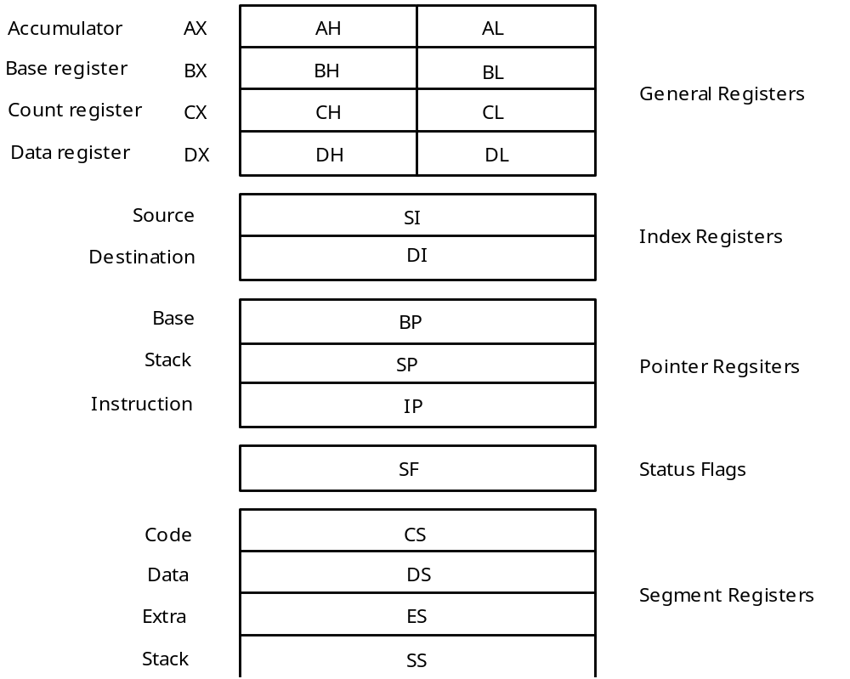
The 8086 Registers

Slide 3
The 8086 Registers
The 8086 microprocessor has a total of fourteen registers that are accessible to the programmer
Eight of the registers are known as general purpose registers i.e. they can be used by the programmer for data manipulation.
Each of the registers is 16 bits long i.e. can contain a 16-bit binary number

Slide 4
The 8086 Registers
The first four registers are sometimes referred to as Data Registers. They are the AX, BX, CX and DX registers.
The second four are referred to as Index/Pointer registers. They are the SP, BP, SI and DI registers.
The Data Registers can be treated as 16-bit registers or they can each be treated as two 8-bit registers.
Each 8-bit register can be used independently.

Slide 5
General Registers
Accumulator
AX
AH
AL
Base register
BX
BH
BL
Count register
General Registers
CX
CH
CL
Data register
DX
DH
DL
8 bits
16 bits
Many instructions in a computer program involve
moving data into and out of these general registers.

Slide 6
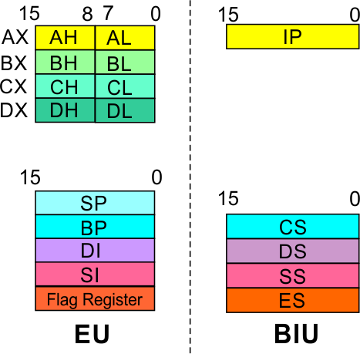
8086 microprocessor
EU
Registers
Accumulator Register (AX)
Consists of two 8-bit registers AL and AH, which can be combined together and used as a 16-bit register AX.
AL in this case contains the low order byte of the word, and AH contains the high-order byte.
The I/O instructions use the AX or AL for inputting / outputting 16 or 8 bit data to or from an I/O port.
Multiplication and Division instructions also use the AX or AL.

Slide 7
8086 microprocessor
EU
Registers
Base Register (BX)
Consists of two 8-bit registers BL and BH, which can be combined together and used as a 16-bit register BX.
BL in this case contains the low-order byte of the word, and BH contains the high-order byte.
This is the only general purpose register whose contents can be used for addressing the 8086 memory.
All memory references utilizing this register content for addressing use DS as the default segment register.

Slide 8
8086 microprocessor
EU
Registers
Counter Register (CX)
Consists of two 8-bit registers CL and CH, which can be combined together and used as a 16-bit register CX.
When combined, CL register contains the low order byte of the word, and CH contains the high-order byte.
Instructions such as SHIFT, ROTATE and LOOP use the contents of CX as a counter.
Example:
The instruction LOOP START automatically decrements CX by 1 without affecting flags and will check if CX = 0.
If it is zero, 8086 executes the next instruction; otherwise the 8086 branches to the label START.

Slide 9
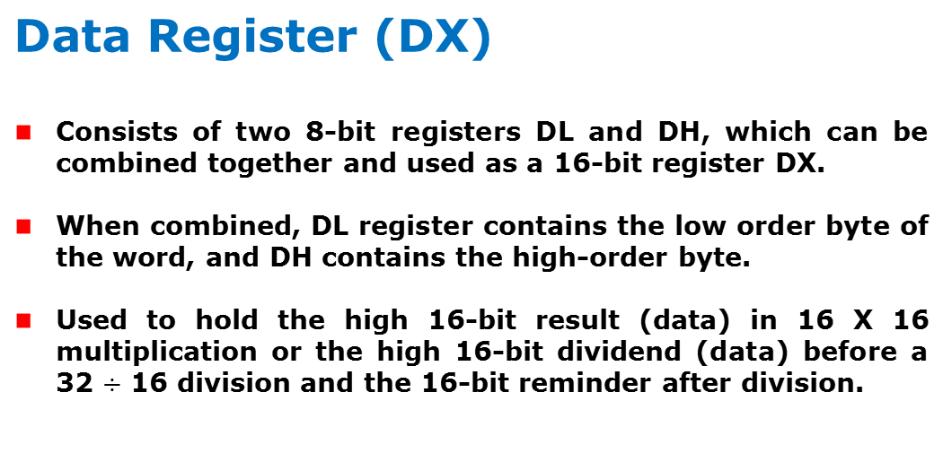
8086 microprocessor
EU
Registers

Slide 10
Index Registers
Source
SI
Index Registers
Destination
DI
Index registers may be used to store 16-bit data.
Index registers are also used as pointers to offset
addresses in memory.
MOV AL,[SI]
means move into AL the byte in the data segment
at the offset address that is in SI.
(if SI=500, then 500 no. address (means data segment) has
some bytes and Transfer the bytes to AL)

Slide 11
Pointer Registers
Base
BP
Stack
SP
Pointer Registers
Instruction
IP
The Instruction Pointer, IP, contains the offset
address of the next instruction to be executed.
The Stack Pointer, SP, contains the offset address
of the top of the stack.
The Base Pointer, BP, is used to access data in
the stack segment.

Slide 12
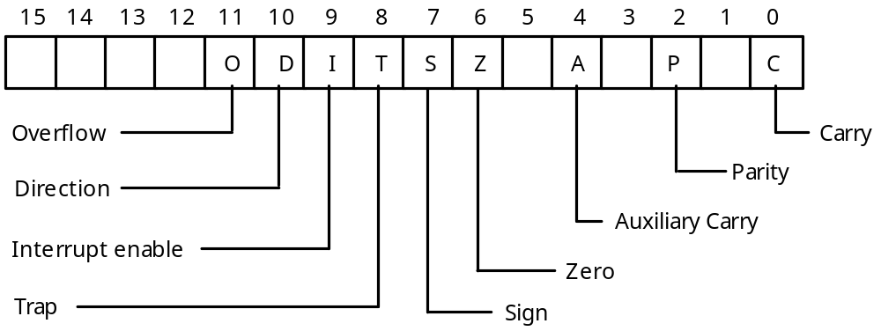
The Status Register

Slide 13
8086 microprocessor
Architecture
Registers and Special Functions
Register | Name of the Register | Special Function
AX | 16-bit Accumulator | Stores the 16-bit results of arithmetic and logic operations
AL | 8-bit Accumulator | Stores the 8-bit results of arithmetic and logic operations
BX | Base register | Used to hold base value in base addressing mode to access memory data
CX | Count Register | Used to hold the count value in SHIFT, ROTATE and LOOP instructions
DX | Data Register | Used to hold data for multiplication and division operations
SP | Stack Pointer | Used to hold the offset address of top stack memory
BP | Base Pointer | Used to hold the base value in base addressing using SS register to access data from stack memory
SI | Source Index | Used to hold index value of source operand (data) for string instructions
DI | Data Index | Used to hold the index value of destination operand (data) for string operations

Slide 14
Segment Registers
Code
CS
Data
DS
Segment Registers
Extra
ES
Stack
SS
Segment registers contain segment addresses.
The Code segment contains the program being executed.
The Data segment contains data (variables).
The Extra segment can be used for anything.
The Stack segment contains the stack.

Slide 15
Architecture
8086 microprocessor
Segment
Registers
Code Segment Register
16-bit
CS contains the base or start of the current code segment; IP contains the distance or offset from this address to the next instruction byte to be fetched.
BIU computes the 20-bit physical address by logically shifting the contents of CS 4-bits to the left and then adding the 16-bit contents of IP.
That is, all instructions of a program are relative to the contents of the CS register multiplied by 10 and then offset is added provided by the IP.

Slide 16
Architecture
8086 microprocessor
Segment
Registers
Data Segment Register
16-bit
Points to the current data segment; operands for most instructions are fetched from this segment.
The 16-bit contents of the Source Index (SI) or Destination Index (DI) or a 16-bit displacement are used as offset for computing the 20-bit physical address.

Slide 17
Architecture
8086 microprocessor
Segment
Registers
Stack Segment Register
16-bit
Points to the current stack.
The 20-bit physical stack address is calculated from the Stack Segment (SS) and the Stack Pointer (SP) for stack instructions such as PUSH and POP.
In based addressing mode, the 20-bit physical stack address is calculated from the Stack segment (SS) and the Base Pointer (BP).

Slide 18
8086 microprocessor
Segment
Registers
Extra Segment Register
16-bit
Points to the extra segment in which data (in excess of 64K pointed to by the DS) is stored.
String instructions use the ES and DI to determine the 20-bit physical address for the destination.

Slide 19
The 8086 Registers

